Slide 1
PURPOSE
To build an Ummati who is of benefit to humanity

Slide 2
VISION
Our vision is to create a learning environment that fosters the development of individuals with exemplary character, academic excellence, and a strong grounding in deen. Through this holistic educational approach, we aspire to empower students to serve the ummah with integrity and responsibility while upholding every aspect of deen without any compromise.

Slide 3
MISSION
To cultivate future generations within a nurturing environment grounded on core islamic values, fostering a profound love for Allah Ta’ala, the holy Quran, and the blessed Sunnah as guided by the Ahlus Sunnah wal Jama’ah and interpreted by the teachings of the four imams and pious predecessors. Our commitment extends to instilling values of respect, honesty, integrity, compassion, ikhlaas (sincerity), and fairness, shaping individuals who embody these virtues in their daily lives and interactions

Slide 4
VALUES
Respect
Ikhlaas And Sincerity
Honesty
Integrity
Fairness
Compassion
Perseverance
Sacrifice

Slide 5
ACCOUNTABILITY
New accountability measures have been introduced with the goal of enhancing the quality of education we provide

Slide 6
SHURA
ML ABDURRAHMAAN
(PRINCIPAL)
ML YUSUF
(DEPUTY PRINCIPAL & HOD BOYS MAKTHAB CONFLICT RESOLUTION OFFICER
APA ASMAA
(DEAN OF GIRLS CAMPUS )
ML MUAAZ
MUFTI DAYA
ML YUSUF
MAINTENANCE
SECURITY
HOD ACADEMICS GRADE RR-3 APA KHADEEJA HASLOD
HOD HIFZ
APA K/APA FAATIMA
HOD ACADEMICS GRADE 4-9
APA ZAKIYYAH
HOD AALIMA
MAKHTAB APA K
APA K
APA SAADIYA
APA HAFSA
APA MAIMOONAH
APA SUMAIYA
APA ZAKIYYAH
APA ASMA
APA AARIFAH
APA AYESHA
APA FAATIMA
APA MAHDYYA
APA HAFSA
APA SUMAIYA
HEAD OF ADMIN NEW APPOINTMENT 01/10/24
USTAAD
TEACHER IMRAAN
MR FARHAN KADWA
HAFEZ ZIYAAD
MR YALCINE
ML MUAAZ
ML ZAKARIYYA
QARI ABED
ML ABDULLAH
MUFT DAYA
QARI IRFAN
HOD ACADEMICS
HAFEZ ZIYAAD, MR YALCINE
HOD HIFZ
APA YASMEEN AND APA ASMAA
APA KHADEEJA
APA AMEERA
APA ZAHEERA

Slide 7
SHURA
ML ABDURRAHMAAN
(PRINCIPAL)
HEAD OF ADMIN NEW APPOINTMENT 01/10/24
USTAAD
TEACHER IMRAAN
MR FARHAN KADWA
HAFEZ ZIYAAD
MR YALCINE
ML MUAAZ
ML ZAKARIYYA
QARI ABED
ML ABDULLAH
MUFT DAYA
QARI IRFAN
HOD ACADEMICS
HAFEZ ZIYAAD, MR YALCINE
HOD HIFZ

Slide 8
SHURA
ML YUSUF
(DEPUTY PRINCIPAL & HOD BOYS MAKTHAB CONFLICT RESOLUTION OFFICER
ML MUAAZ
MUFTI DAYA
ML YUSUF
MAINTENANCE
SECURITY

Slide 9
SHURA
APA ASMAA
(HEAD OF GIRLS CAMPUS )
HOD ACADEMICS GRADE RR-3
HOD HIFZ
APA K/APA FAATIMA
HOD ACADEMICS GRADE 4-9
HOD AALIMA
MAKHTAB APA K
APA K
APA ZAAKIRAH
APA HAFSA
APA MAIMOONAH
APA SUMAIYA
APA NAZEERA
APA AMANAH
APA AYESHA
APA FAATIMA
APA HAFSA
APA SUMAIYA
APA YASMEEN AND APA ASMAA
APA MARIAM
APA AMEERA
APA NASREEN

Slide 10
Included in these measures are the following
Fully registered with the Department of Education
Ensuring accountability from all staff
Standardization of working hours
Professionalizing our admin department
D6 communicator & fee statements
Timeous academic interventions when needed for students
Improving parent / teacher interaction & communication
Hifz & Makhtab update

Slide 11
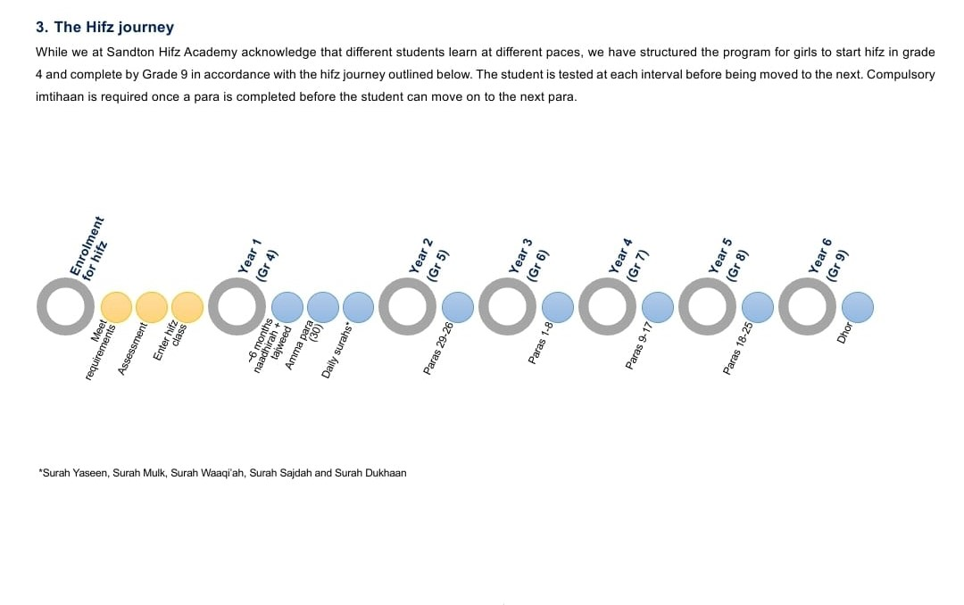

Slide 12
Acquisition of the new property
Update of the future building project
Introduction of extra curricular activities in the future
Payment of fees timeously
Productive collaboration between parents and the school
Question & Answers?

